Slide 1
CS 4731: Computer Graphics
Lecture 20: Raster Graphics Part 1
Emmanuel Agu

Slide 2
2D Graphics Pipeline
Clipping
Object
World Coordinates
Applying
world window
Object
subset
window to
viewport
mapping
Simple 2D Drawing Pipeline
Display
Rasterization
Object
Screen coordinates

Slide 3
Rasterization (Scan Conversion)
Convert high-level geometry description to pixel colors in the frame buffer
Example: given vertex x,y coordinates determine pixel colors to draw line
Two ways to create an image:
  Scan existing photograph
  Procedurally compute values (rendering)
Viewport Transformation
Rasterization

Slide 4
Rasterization
A fundamental computer graphics function
Determine the pixels’ colors, illuminations, textures, etc.
Implemented by graphics hardware
Rasterization algorithms
  Lines
  Circles
  Triangles
  Polygons

Slide 5
Rasterization Operations
Drawing lines on the screen
Manipulating pixel maps (pixmaps): copying, scaling, rotating, etc
Compositing images, defining and modifying regions
Drawing and filling polygons
  Previously glBegin(GL_POLYGON), etc
Aliasing and antialiasing methods

Slide 6
Line drawing algorithm
Programmer specifies (x,y) values of end pixels
Need algorithm to figure out which intermediate pixels are on line path
Pixel (x,y) values constrained to integer values
Actual computed intermediate line values may be floats
Rounding may be required. E.g. computed point
(10.48, 20.51) rounded to (10, 21)
Rounded pixel value is off actual line path (jaggy!!)
Sloped lines end up having jaggies
Vertical, horizontal lines, no jaggies

Slide 7
Line Drawing Algorithm
8
7
6
5
4
3
2
1
Line: (3,2) -> (9,6)
?
Which intermediate
pixels to turn on?
0 1 2 3 4 5 6 7 8 9 10 11 12

Slide 8
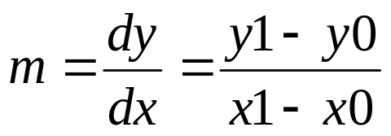

Line Drawing Algorithm
Slope-intercept line equation
  y = mx + b
  Given two end points (x0,y0), (x1, y1), how to compute m and b?
(x1,y1)
dy
(x0,y0)
dx

Slide 9
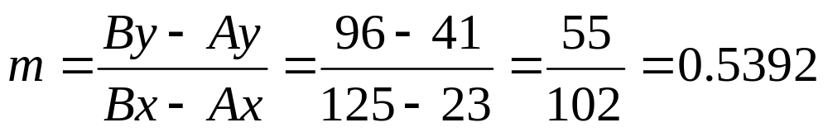
Line Drawing Algorithm
Numerical example of finding slope m:
(Ax, Ay) = (23, 41), (Bx, By) = (125, 96)

Slide 10
Digital Differential Analyzer (DDA): Line Drawing Algorithm
Walk through the line, starting at (x0,y0)
Constrain x, y increments to values in [0,1] range
Case a: x is incrementing faster (m < 1)
  Step in x=1 increments, compute and round y
Case b: y is incrementing faster (m > 1)
  Step in y=1 increments, compute and round x
(x1,y1)
dy
(x0,y0)
dx

Slide 11
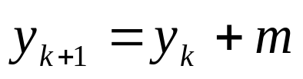
DDA Line Drawing Algorithm (Case a: m < 1)
x = x0 y = y0
Illuminate pixel (x, round(y))
(x1,y1)
x = x0 + 1
y = y0 + 1 * m
Illuminate pixel (x, round(y))
x = x + 1
y = y + 1 * m
Illuminate pixel (x, round(y))
…
Until x == x1
(x0, y0)

Slide 12
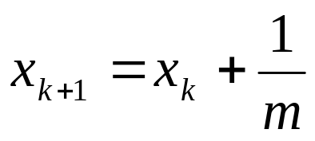
DDA Line Drawing Algorithm (Case b: m > 1)
x = x0 y = y0
(x1,y1)
Illuminate pixel (round(x), y)
y = y0 + 1
x = x0 + 1 * 1/m
Illuminate pixel (round(x), y)
y = y + 1
x = x + 1 /m
Illuminate pixel (round(x), y)
…
(x0,y0)
Until y == y1

Slide 13
DDA Line Drawing Algorithm Pseudocode
compute m;
if m < 1:
{
float y = y0; // initial value
for(int x = x0;x <= x1; x++, y += m)
setPixel(x, round(y));
}
else // m > 1
{
float x = x0; // initial value
for(int y = y0;y <= y1; y++, x += 1/m)
setPixel(round(x), y);
}
Note: setPixel(x, y) writes current color into pixel in column x and row y in frame buffer

Slide 14
Line Drawing Algorithm Drawbacks
DDA is the simplest line drawing algorithm
  Not very efficient
  Round operation is expensive
Optimized algorithms typically used.
  Integer DDA
  E.g.Bresenham algorithm (Hill, 10.4.1)
Bresenham algorithm
  Incremental algorithm: current value uses previous value
  Integers only: avoid floating point arithmetic
  Several versions of algorithm: we’ll describe midpoint version of algorithm

Slide 15
Bresenham’s Line-Drawing Algorithm
Problem: Given endpoints (Ax, Ay) and (Bx, By) of a line, want to determine best sequence of intervening pixels
First make two simplifying assumptions (remove later):
  (Ax < Bx) and
  (0 < m < 1)
Define
  Width W = Bx – Ax
  Height H = By - Ay

Slide 16
Bresenham’s Line-Drawing Algorithm
Based on assumptions:
  W, H are +ve
  H < W
As x steps in +1 increments, y incr/decr by <= +/–1
y value sometimes stays same, sometimes increases by 1
Midpoint algorithm determines which happens

Slide 17
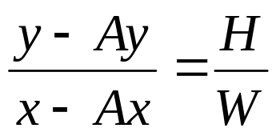
Bresenham’s Line-Drawing Algorithm
Using similar triangles:
H(x – Ax) = W(y – Ay)
-W(y – Ay) + H(x – Ax) = 0
Above is ideal equation of line through (Ax, Ay) and (Bx, By)
Thus, any point (x,y) that lies on ideal line makes eqn = 0
Doubling expression and giving it a name,
F(x,y) = -2W(y – Ay) + 2H(x – Ax)

Slide 18
Bresenham’s Line-Drawing Algorithm
So, F(x,y) = -2W(y – Ay) + 2H(x – Ax)
Algorithm, If:
  F(x, y) < 0, (x, y) above line
  F(x, y) > 0, (x, y) below line
Hint: F(x, y) = 0 is on line
Increase y keeping x constant, F(x, y) becomes more negative

Slide 19
Bresenham’s Line-Drawing Algorithm
Example: to find line segment between (3, 7) and (9, 11)
F(x,y) = -2W(y – Ay) + 2H(x – Ax)
= (-12)(y – 7) + (8)(x – 3)
For points on line. E.g. (7, 29/3), F(x, y) = 0
A = (4, 4) lies below line since F = 44
B = (5, 9) lies above line since F = -8

Slide 20
Bresenham’s Line-Drawing Algorithm
(x1,y1)
What Pixels to turn on or off?
Consider pixel midpoint M(Mx, My)
M = (x0 + 1, Y0 + ½)
If F(Mx,My) < 0, M lies above line,
shade lower pixel
M(Mx,My)
If F(Mx,My) > 0, M lies above line,
shade upper pixel(same y as before)
…
(x0, y0)

Slide 21
Bresenham’s Line-Drawing Algorithm
Algorithm: // loop till you get to ending x
  Set pixel at (x, y) to desired color value
  x++
    if F < 0
      F = F + 2H
    else
      Y++, F = F - 2(W – H)
Recall: F is equation of line

Slide 22
Bresenham’s Line-Drawing Algorithm
Final words: we developed algorithm with restrictions
Can add code to remove restrictions
  To get the same line when Ax > Bx (swap and draw)
  Lines having slope greater than unity (interchange x with y)
  Lines with negative slopes (step x++, decrement y not incr)
  Horizontal and vertical lines (pretest a.x = b.x and skip tests)
Important: Read Hill 10.4.1

Slide 23
References
Hill, chapter 10

